Slide 1
Switching Behavior of Izhikevich Model
Yoon JaeHong, Zhongxi Li
2017 November

Slide 2
Outline
Goal, background, motivation
Demo of the Izhikevich switching behavior
Valid parameters (a, b) via genetic algorithm
Setting
Goal function
algorithm
Analytical solution of (a, b)
Discussion
Extension to multiple neurons

Slide 3
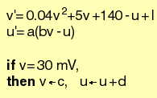
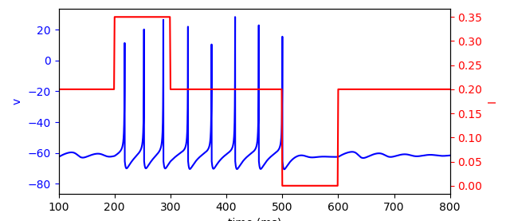
Goal
Find and explain a set of parameters such that one Izhikevich-type neuron can exhibit bi-stability.
Izhikevich model
Switching behavior
Turn on
Turn off

Slide 4
Motivation and Challenges
Motivation:
We believe biological working memory can be carried out by a single neuron with a clean mathematical interpretation.
Challenges:
The Izhikevich model is defined in a hybrid manner. The conditions make the model discontinuous.

Slide 5
Motivation and Challenges
Genetic algorithm → parameter set (a, b)
Izhikevich model
Define switching behavior
Explanation
Nonlinear dynamics analysis

Slide 6
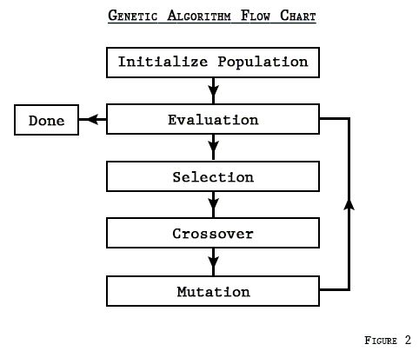
Path 1: genetic algorithm
Basic idea: select the best parameters from a pool of candidates. The best parameters then become parents of the next candidate generation.

Slide 7
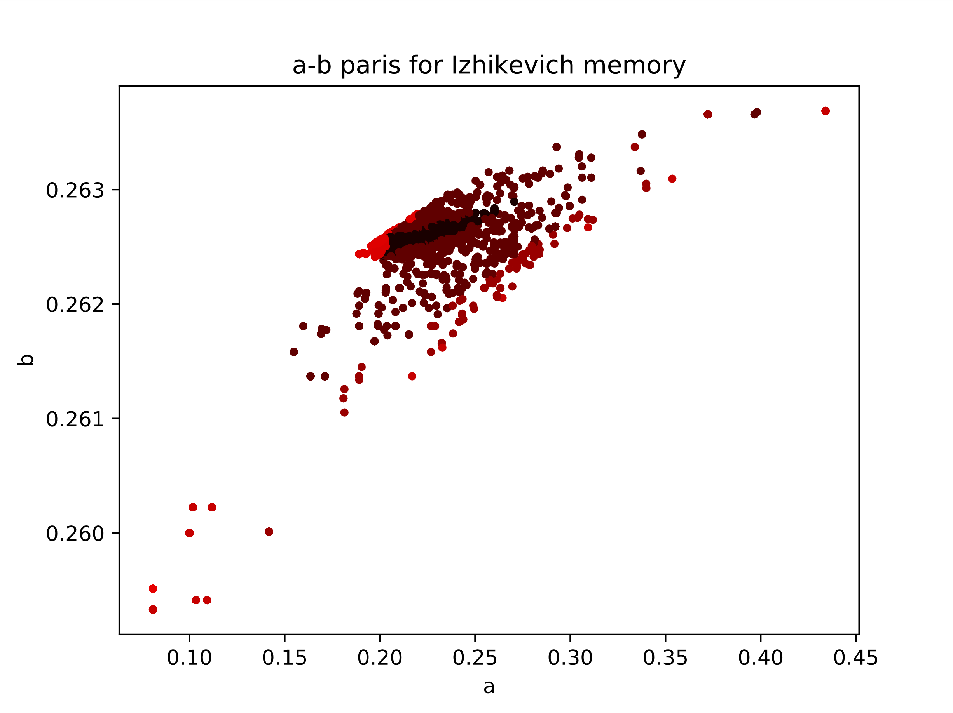
Path 1: genetic algorithm

Slide 8
Path 2: Bifurcation analysis
First, observe phase portraits of an exemple (a,b) = (0.1, 0.26) (reference)
2
1
3
4
5
1
2
3
4
5
saddle point
saddle point
saddle point
saddle point
saddle point
stable spirals
unstable spirals
stable spirals
stable spirals
stable spirals
Observation: the switching behavior is associated to a Hopf-bifurcation

Slide 9
Path 2: Bifurcation analysis
For fixed (a, b) = (0.1, 0.26) , sweep the stimulus current
Could be interesting to overlay the trajectory over this bifurcation plot
So that we see how to shut it down
Add another figure for u* fixed point
I = 0.35
I = 0.15
Hopf-bifurcation
The bi-stability happens here
conclusion: the bi-stability of Izhikevich model may related to Hopf-bifurcation
Notes:
For hopf-bifur, de we need to find a limit cycle to catch that?

Slide 10
Path 2: Bifurcation analysis
Find more parameters that enables Hopf-bifurcation
current I
If goes across tau=0
I = 0.0
There are missing parts
→ Other bifurcation exists
If delta > 0
I = 0.4
Genetic algorithm findings with I switching between 0.2 and 0.35
(a, b) curve
Notes:
Delta > 0 otherwise there is no stability change

Slide 11
Phase portrait of another (a, b) point
(a, b) = (0.2958, 0.263)
saddle point
nothing
saddle point
saddle point
saddle point
stable spirals
stable spirals
stable spirals
stable spirals

Slide 12
Phase portrait of another (a, b) point
For fixed (a, b) = (0.2958, 0.263), sweep the stimulus current
Looks like that a saddle-node bifurcation is causing the bi-stability.
Wrong! The saddle point was already there before the stimulation; it is the annihilation of the fixed points that produce the bi-stability
Notes:
Somehow couldn’t reach the small region near Delta=0, can’t visualize what’s happening inside.

Slide 13
Path 2: Bifurcation analysis
Patch parameters that enables saddle-node bifurcation
current I
Due to annihilation of two stable fixed points
Due to Hopf-bifurcation
I = 0.0
I = 0.4
Genetic algorithm findings with I switching between 0.2 and 0.35
(a, b) curve
Notes:
Delta > 0 otherwise there is no stability change

Slide 14
Limit Cycle
How come that there is a limit cycle around nothing (no fixed points)?

